Slide 1
Name: Muhammad ashraf roll: 19sw19 subject: web development

Slide 2
My intro: & Brief overview of web development
This is Muhammad Ashraf, from the Software Department, at Mehran University of Engineering & Technology, Jamshoro. I am currently enrolled in final year 7th semester.
I have keen interest in learning Web development.
Web development refers to the process of creating, designing, building, and maintaining websites and web applications. It involves using various programming languages, such as HTML, CSS, and JavaScript, to create the user interface, functionality, and appearance of a website or web application.
Web development can be divided into two main categories: front-end development and back-end development. Front-end development involves creating the user interface of a website or web application, such as the layout, colors, and typography, using HTML, CSS, and JavaScript. Back-end development involves building the server-side of a website or web application, such as the database, server-side programming, and APIs.
Web development can also involve other technologies such as content management systems (CMS), e-commerce platforms, and web hosting services. Web developers may work in teams or as individuals, and their work can vary from creating simple static websites to building complex web applications that require extensive programming and database integration.

Slide 3
HOW I GET THERE
Becoming a web developer typically requires a combination of education, training, and practical experience. Here are some steps you can take to become a web developer:
Education: Many web developers have a degree in computer science or a related field, such as software engineering or information technology. A formal education can provide a strong foundation in programming concepts, algorithms, data structures, and other essential skills.
Learn programming languages and tools: Familiarize yourself with programming languages such as HTML, CSS, JavaScript, and other web development tools such as text editors, integrated development environments (IDEs), and version control systems.
Build a portfolio: Create a portfolio of your work to showcase your skills and knowledge to potential employers. This can include personal projects, open source contributions, and work you have done for clients.
Gain practical experience: Look for opportunities to gain practical experience, such as internships, freelance work, or volunteering on open-source projects. Practical experience can help you build your skills, learn new technologies, and establish a network of contacts in the industry.
Stay up-to-date with industry trends and technologies: The field of web development is constantly evolving, so it's important to stay current with new trends and technologies. Attend conferences, read industry blogs and articles, and take online courses to keep up-to-date with the latest developments.
Consider certification: While not required, obtaining industry certifications can help demonstrate your knowledge and expertise in a specific area of web development.
Overall, becoming a web developer requires a combination of education, practical experience, and a willingness to continuously learn and adapt to new technologies and trends.

Slide 4
What is seem’s fascinating in web development
There are many aspects of web development that can be fascinating and rewarding to someone in this field. Here are a few:
Creativity: Web development allows you to use your creativity to design and build websites and web applications. You can experiment with different layouts, colors, fonts, and images to create a unique user experience.
Constant innovation: The web development industry is constantly evolving, with new technologies and tools emerging all the time. This means that you will always have the opportunity to learn and try out new things.
Flexibility: Web development can be done remotely, which gives you the flexibility to work from anywhere in the world. This can be especially appealing to those who value work-life balance and want to have more control over their schedule.
Job demand: As more businesses move online, there is an increasing demand for web developers. This means that there are often many job opportunities available, and you can choose to work in a variety of industries.
Problem-solving: Web development requires a lot of problem-solving skills, as you will encounter many challenges while building websites and web applications. This can be both challenging and rewarding, as you will have the satisfaction of solving complex problems and creating solutions that work.
Overall, web development can be an exciting and rewarding field for those who enjoy using their creativity, staying up-to-date with new technologies, and solving complex problems.

Slide 5
current achievements of mine
I have joined an internship in web development approximately 1 month ago, during which I learned how to create amazing websites and learned how to monetize my skill, below are the actions I took during that course.
I created accounts on fiverr and upwork, from fiverr I got a job to create some landing pages, I delivered these projects on time and got the respective fee, and after that I got another job to create a website for school management system and after completing this my earnings increased. With my professional delivery of the projects my gig started to rank on the first pages of fiverr, I am doing same in other freelancing websites like upwork.

Slide 6
Why I choose web development
There are many reasons why someone might choose web development as a career or hobby:
High Demand: Web development is in high demand as more and more businesses are shifting online. This means that there are plenty of job opportunities available for those with web development skills.
Flexibility: Web development can be done remotely from anywhere in the world. This allows for a lot of flexibility in terms of work location and schedule.
Creative Outlet: Web development provides a creative outlet for those who enjoy building things from scratch. Web developers can take pride in seeing their work come to life online.
Constant Learning: Web development is a constantly evolving field. New technologies and frameworks are being introduced all the time, which means that web developers must be constantly learning in order to stay up-to-date.
Good Pay: Web development can be a well-paying career, especially for those with experience and expertise in the field.
Overall, web development offers a challenging and rewarding career path for those with an interest in technology and a desire to create something meaningful online.

Slide 7
What pathways I followed
I learned most of the web development from online courses on youtube channels like CodeWithHarry, Edureka, and with newly learned skill I applied for several internships and I got some of them. With these online courses and internships, I set my path to cement and better my web development skills along with some auxiliary skills like Web design and firebase.

Slide 8
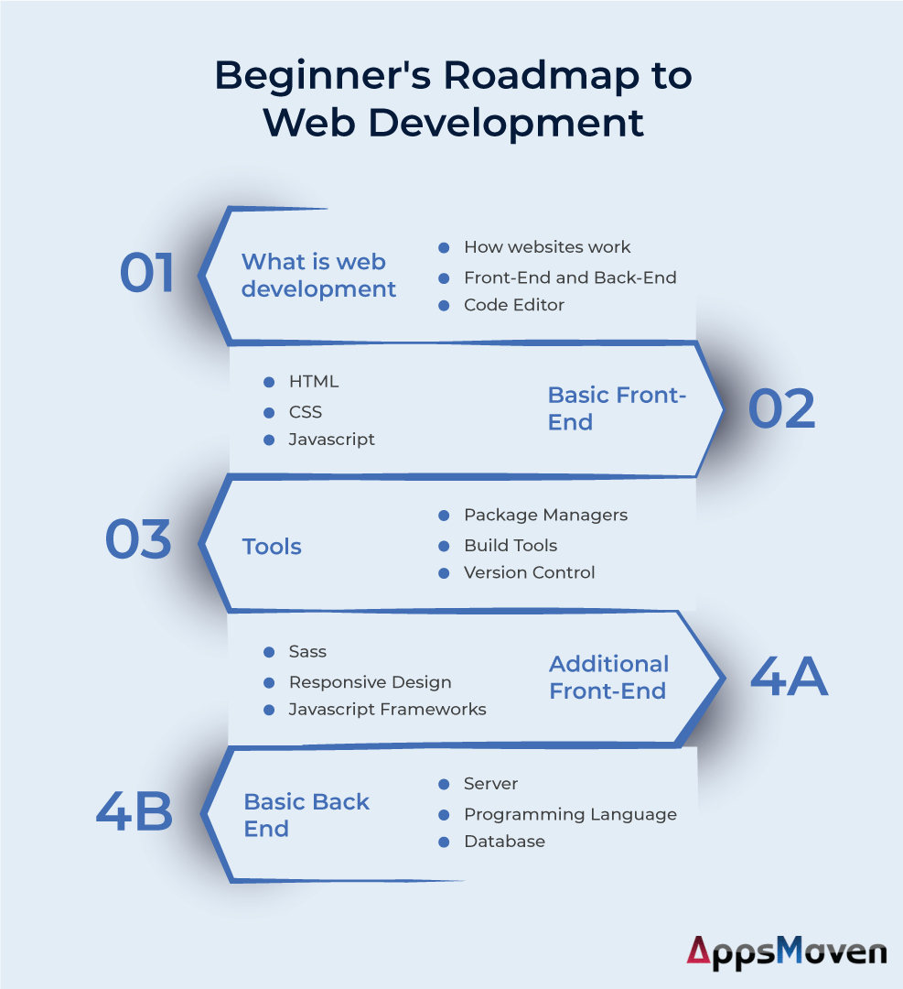

Slide 9
How would you guide others if someone wants to pursue web development.
If someone wants to pursue web development, here are some steps that can guide them:
Learn the basics of HTML, CSS, and JavaScript: These are the foundational languages of web development. Start by learning the basics of HTML for creating the structure of web pages, CSS for styling the web pages and JavaScript for adding interactivity.
Practice coding: The more you practice coding, the better you'll become at it. Practice coding by creating small projects, like a simple website, and gradually work your way up to more complex projects.
Choose a framework: There are several popular web development frameworks, such as React, Angular, and Vue.js. Choose a framework that suits your needs and learn it well. Frameworks can simplify web development by providing pre-built components and libraries.
Learn back-end development: Back-end development involves working with server-side languages and databases. Popular server-side languages include Python, Ruby, and Node.js.
Build a portfolio: Build a portfolio of your projects to showcase your skills to potential employers or clients. This can include personal projects, open-source contributions, or freelance work.
Keep learning: The web development landscape is constantly evolving, so it's important to stay up-to-date with the latest technologies and trends. Attend conferences, read blogs, and follow industry leaders on social media to stay informed.
Network: Network with other web developers, attend meetups and conferences, and join online communities to connect with other developers and learn from their experiences.
Remember that web development is a constantly evolving field, so it's important to stay up-to-date with the latest technologies and trends. With dedication and practice, anyone can become a successful web developer.

Slide 10
Pros and cons of web development
Pros:
High demand: There is a high demand for web developers, and the job market is expected to continue to grow.
Flexibility: Web development can be done remotely and offers flexible work hours, making it a good option for those who prefer a work-life balance.
Creativity: Web development allows for creativity in design and functionality, which can be rewarding for those who enjoy visual and interactive aspects of web design.
Variety: Web development offers a range of opportunities and roles, such as front-end development, back-end development, and full-stack development, allowing individuals to specialize or have a broader skillset.
Cons:
Continuous learning: Web development is a constantly evolving field, requiring developers to keep up with new technologies and trends, which can be overwhelming and time-consuming.
Competition: With the high demand for web developers, competition can be fierce, and developers may need to continually improve their skills and portfolio to stand out.
Repetitive tasks: Certain tasks, such as testing and debugging, can be repetitive and time-consuming.
Sitting for long hours: Web development involves sitting in front of a computer for extended periods, which can lead to health problems such as eye strain, back pain, and repetitive strain injury.

Slide 11
Future trends
Web development is a rapidly evolving field, and it's important for developers to stay up-to-date with the latest trends and technologies to remain competitive. Here are some of the future trends of web development:
Progressive Web Apps (PWAs): PWAs are web applications that look and function like native mobile apps. They offer users an app-like experience, without the need to download an app from an app store.
Artificial Intelligence (AI): AI is increasingly being integrated into web development, from chatbots that can provide customer support to personalized recommendations and predictive analytics.
Voice User Interface (VUI): With the increasing use of smart speakers and voice assistants, VUI is becoming an important aspect of web development. Websites and applications are being designed to work with voice commands and natural language processing.
Single-page applications (SPA): SPAs load all necessary resources on a single page, providing a faster and smoother user experience. They are becoming increasingly popular for web applications.
Motion UI: Motion UI involves adding animations, transitions, and other visual effects to web pages to improve the user experience and make the website more engaging.
Web Assembly (WASM): WASM is a new technology that allows developers to write high-performance applications in languages such as C++ and Rust, which can run in web browsers.
Blockchain: Blockchain technology is being integrated into web development, for applications such as digital identities, secure transactions, and decentralized apps (dApps).
Cybersecurity: With the increasing threats of cyber attacks, cybersecurity is becoming an increasingly important aspect of web development. Developers are integrating security features into their websites and applications to protect user data and prevent breaches.

